Slide 1
Introduction to Object-Oriented Program
CS 244

Slide 2
Acknowledgement
Some of the slides and graphics are courtesy of Moufaz Haddara, Associate Professor,
Westerdale Oslo School of Arts, Communication and Technology

Slide 3
Overview of Object-Oriented Program (OOP)
Introduction
Basic concepts
Wrap-up

Slide 4
Programming Language Families
Machine languages
Assembly languages
High-Level languages

Slide 5
Programming Language Families
Machine languages
consist only on 0’s and 1’s, hard to program
code example:
1110100010101 111010101110 10111010110100 10100011110111
Assembly languages
easier programming, tied to a specific processor, must be
translated into machine language, code example:
ADD 11001111, 10010011
High-level languages
much easier to program, syntax closer to English

Slide 6
High-level languages
Divided into three main groups referred to as paradigms. Examples below have features supporting specific paradigms.
Procedural: C, C++, Eiffel, Python
Object-oriented features: C++, Java, Python, Ruby, Objective C
Functional: Scheme, Haskell, Clojure
(Logic programming is another paradigm less widely-used, example: Prolog)

Slide 7
Object-oriented Programming
Based on a programming design philosophy
Everything is grouped into self-sustainable “objects”
Emphasis on reusability

Slide 8
Object-oriented Programming
• In OOP programmers define not only the data type of a data structure, but also the types of operations/methods (functions) that can be applied to the data structure.
• In this way, the data structure becomes an object that includes both data and functions (methods) in one unit.
• Programmers can create relationships between one object and another. For example, objects can inherit characteristics from other objects.

Slide 9
OOP
Key idea in object-oriented programming:
The real world can be “accurately” described as a collection of objects that interact.
Basic concepts:
-A thing (a noun) with properties or attributes
-Method: an action performed by an object (a verb)

Slide 10
Class
- a category of similar objects (such as automobiles), does not hold any values of the object’s attributes/properties

Slide 11
Classes and Objects
A class is a prototype, idea, and blueprint for creating objects.
An object is an instance of a class.
For example, in C++ we define classes, which in turn are used to create objects
A class has a constructor for creating objects
A class is composed of three things: its name, attributes/properties, and methods.

Slide 12
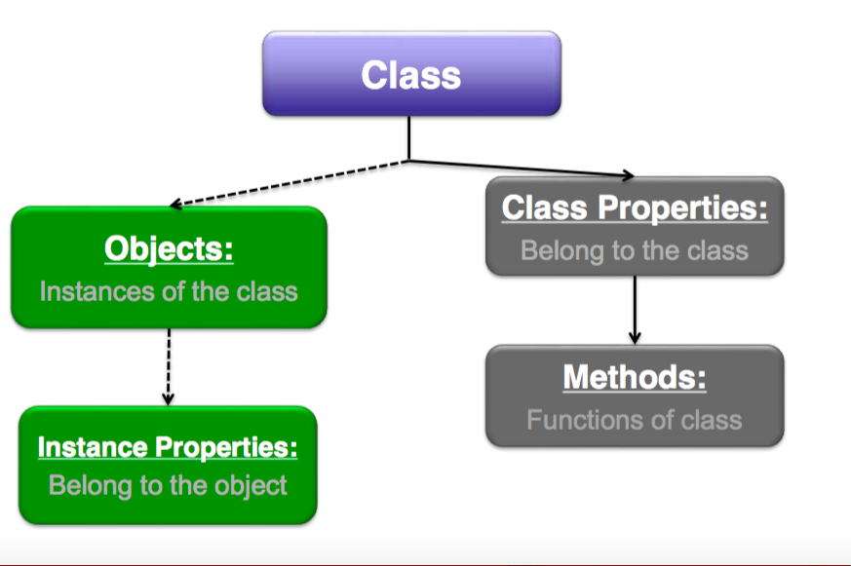
Classes and Objects

Slide 13
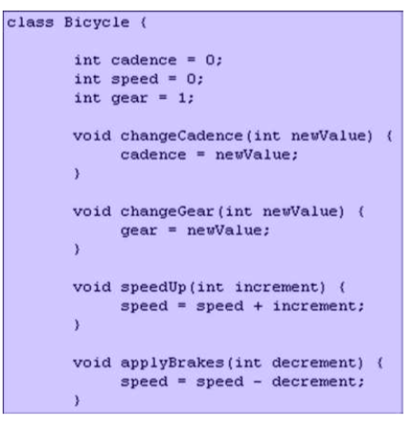
Classes and Objects
A class is a definition of objects with the same properties and the same methods.
cadence in the Bicycle class is the number of revolutions per minute (rpm).

Slide 14
Classes and Objects
Almost everything in the world can be represented as an object
A flower, a tree, an animal
A student, a professor
A desk, a chair, a classroom, a building
A university, a city, a country
The world, the universe
A subject such as CS, Math, History, ...
An information system, financial, legal, etc..

Slide 15
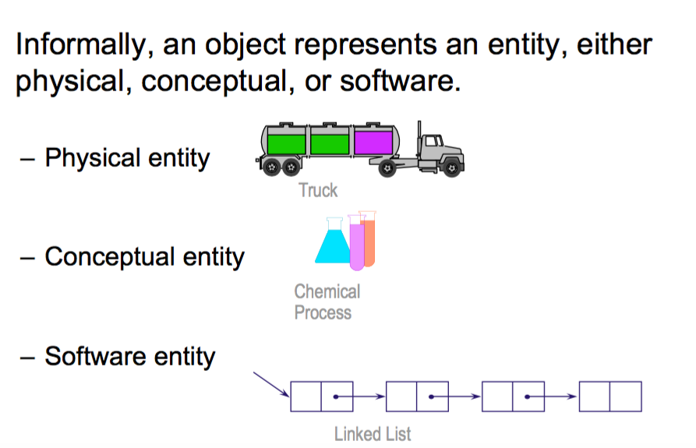
More about objects…

Slide 16
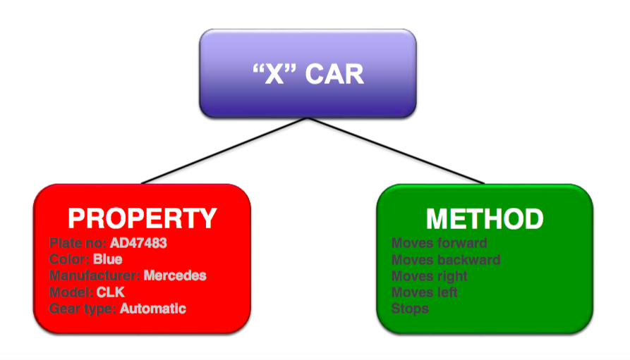
Classes and Objects

Slide 17
Class and Objects
-Each copy of an object from a particular class is called an instance of the class.
-Creating a new instance of a class is called instantiation.

Slide 18
Classes and Objects - Examples
Homo Sapien is a class, John and Jack are objects
Animal is a class, “Snowball” the cat is an object
Vehicle is a class, your BMW is an object
Galaxy is a class, the Milky Way is an object

Slide 19
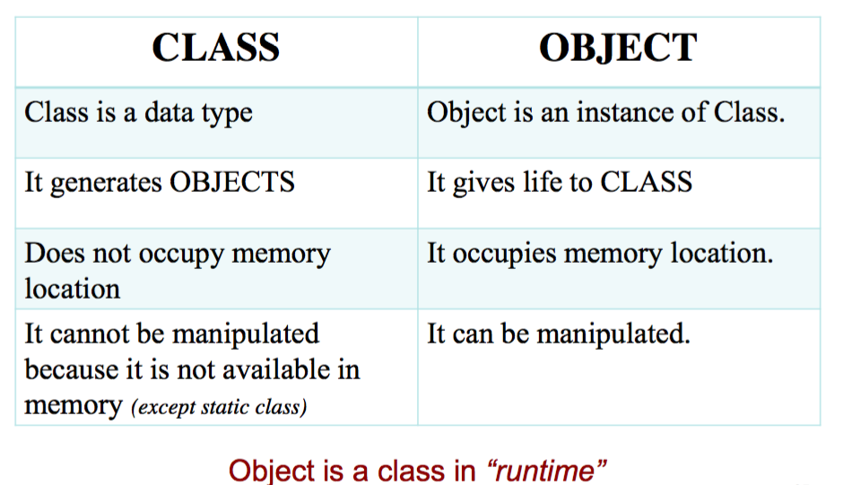

Slide 20
Objects
-Objects are useless unless they can collaborate together to solve a problem.
–Each object is responsible for its own behavior and status.
–No one object can carry out every responsibility on its own.

Slide 21
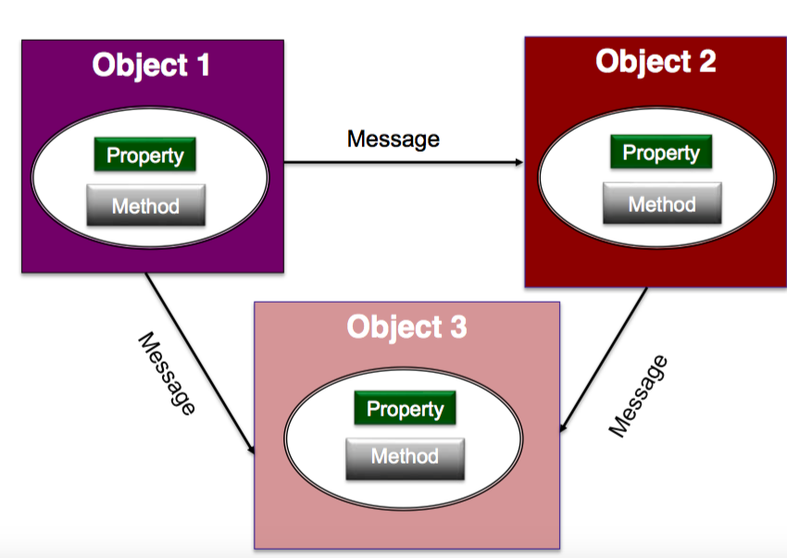
Object interaction

Slide 22
Basic Concepts of Object-Oriented Programming
Encapsulation
Inheritance
Abstraction
Polymorphism

Slide 23
Encapsulation
The class is kind of a container or capsule or a cell, which encapsulate the set of methods, attributes and properties to provide its indented functionalities to other classes.
Encapsulation also allows a class to change its internal implementation without hurting the overall functioning of the system.
That idea of encapsulation is to hide how a class does its operations while allowing requests for its operations.

Slide 24
Encapsulation Benefits
Ensures that structural changes remain local:  Changing the class internals does not affect any code
outside of the class
✴ Changing methods does not affect the clients using them
→ Encapsulation allows adding some access of client's data
implementation logic when e.g. validation on modifying a property value  Hiding implementation details reduces complexity
→easier maintenance

Slide 25
Inheritance
Inheritance—a way of organizing classes
Term comes from inheritance of traits like eye color, hair color, etc.
Classes with properties in common can be grouped so that their common properties are only defined once in parent class.
Superclass – passes its attributes & methods to the subclass(es).
Subclass – can inherit all its superclass attributes & methods besides having its own unique attributes & methods.

Slide 26
Inheritance
Inheritance allows child classes to inherit the characteristics of existing parent class.
• Attributes (fields and properties) and operations (methods)
• Child class can extend the parent class and add new fields and methods
• Redefine methods (modify existing behavior)

Slide 27
Inheritance
Expresses commonality among classes/objects
Allows code reusability
Highlights relationships
Helps in code organization

Slide 28
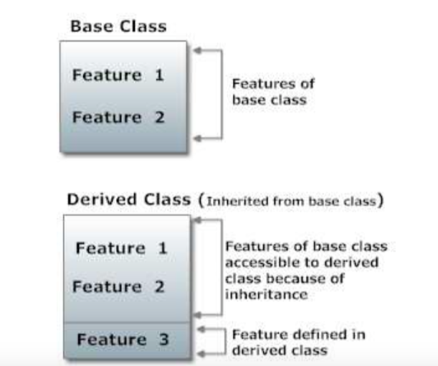
Inheritance

Slide 29
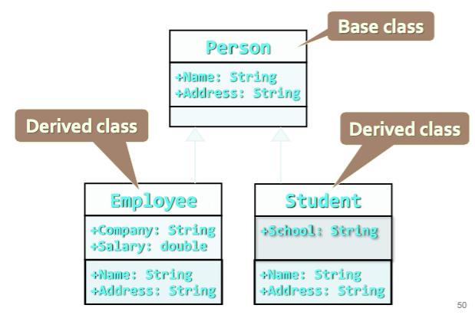
Inheritance

Slide 30
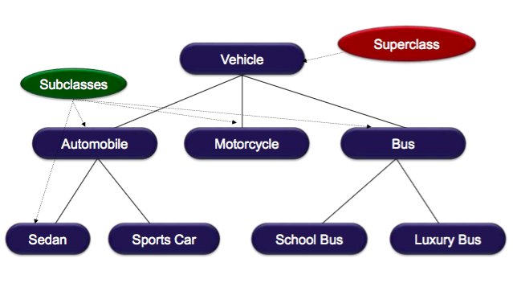
Inheritance Example

Slide 31
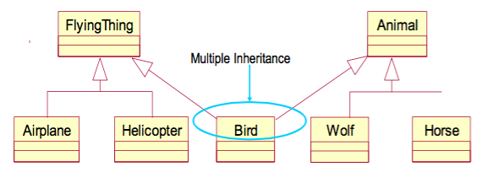
Multiple Inheritance
C++ supports multiple inheritance but not all OOP languages do.

Slide 32
Abstraction
Concrete class can be instantiated directly
Abstract class cannot be instantiated directly
Abstraction is a design principle.
It is the process of removing characteristics from something in order to reduce it to a set of essential characteristics.
Through the process of abstraction, a programmer hides all but the relevant data about a class in order to reduce complexity and increase reusability.
Abstraction is a basic representation of a concept.

Slide 33
Abstraction – Example 1
Person – dob, Name and address – abstract class
Student – Dob, Name and address, college, major, gpa – concrete class
Professor – dob, name and address, specialization, title, etc. - concrete

Slide 34
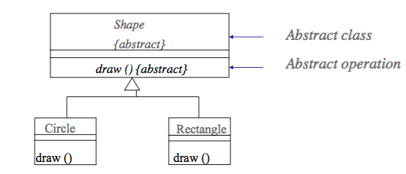
Abstraction – Example 2
An abstract class is a class that may not have any direct instances.
An abstract operation is an operation that is incomplete and requires a child to supply an implementation of the operation.

Slide 35
Polymorphism
Encapsulation, Inheritance, and Abstraction concepts are very related to Polymorphism.
Dictionary definition: “Condition of occurring in several different forms”
Example: a shape exists in different forms, e.g. rectangle, triangle, etc.

Slide 36
Polymorphism in OOP
Polymorphisms means the ability to request that the same methods be performed by a wide range of different types of things.
In OOP, polymorphisms is both a technical issue and principle.
It is achieved by using many different techniques named method overloading, operator overloading, and method overriding.
An object has “multiple identities”, based on its class inheritance tree
It can be used in different ways

Slide 37
Polymorphism
Consider a shape class. It has a draw method but that method cannot be implemented without specific shapes, e.g. rectangle, triangle, circle, etc.
Consider array of shapes with circles, rectangles, and other subclasses of the shape class. Each type has its own draw method and uses the same name, draw() . Each concrete shape would implement the draw method associated with that shape by overriding the draw method of the shape class.
Methods like drawcircle(), drawtriangle(), etc. are not needed.

Slide 38
Advantages of OOP
Object oriented programming is good in complex projects or modular type of systems. It allows simultaneous system development teams
Code reuse & recycling
Improved software-development productivity
Improved software maintainability
Faster development
Lower cost of development
Higher-quality software
Encapsulation

Slide 39
Disadvantages
Could lead to larger program sizes
Could produce slower programs
Learning curve over procedural programming

